Slide 1
Slots 03-04 Basic Computations
Variables
Basic Memory Operations
Expressions
Notes:
Prepared by Thân Văn Sử

Slide 2
Objectives
A problem needs to be represented by data. After studying this chapter, you should be able to:
Understand what is a data type
Declare constants and variables of a program
Express operations on data

Slide 3
Contents
Variables and Data types
Data Types
Integral Types
Floating-Point Types
Declarations
Basic Memory Operations
Literals
Constants
Assignment Operator
Output
Input
Expressions
Arithmetic
In-Class Problem
Statistics: Which operators should be used?
Relational
Logical
Bit operators
Shorthand Assignment Operators
Mixing Data Types
Casting
Precedence

Slide 4
Review
Computer program: A set of instructions that computer hardware will execute.
Issues for a program/software: Usability, Correctness, Maintainability, Portability
Computer software: A set of related programs
Steps to develop a software: Requirement collecting, Analysis, Design, Implementing, Testing, Deploying, Maintaining
Data: Specific values that describe something
Information: Mean of data
Fundamental Data Units: Bit, Nibble, Byte, KB, MB, GB, TB
Data Representation: Number systems: 2, 10, 8, 16
Program Instructions: <opcode, operand1, operand 2>
Programming Languages: Machine language, Assembly, High-level languages

Slide 5
Introduction
Instruction: A task that hardware must perform on data.
Data can be: constants, variables.
Constants: Fixed values that can not be changed when the program executes.
Variables: Values can be changed when the program execute.
Data must be stored in the main memory (RAM).
2 basic operations on data are READ and WRITE.
Numerical data can participate in expressions.

Slide 6
1- Variables and Data Types
A variable is a name referencing to a memory location (address)
Holds binary data
2 basic operations: set value, get value.
When the program is compiled, the compiler will determine the position where the variable is allocated.
Questions:
Where is it? → It’s Address
How many bytes does it occupy? → Data type
0000 1001
1100 0011
c
b
a

Slide 7
Variables and Data Types…
Data Types:
Typed languages, such as C, subdivide the universe of data values into sets of distinct type.
A data type defines:
How the values are stored and
How the operations on those values are performed.
Typed languages defined some primitive data types.
Notes:
*Data type phải là số thực và số tự nhiên

Slide 8
Variables and Data Types…
C has 4 primitive data types:
Type | Length | Range
int | Word (length of CPU register) | -32,768 to 32,767 (16 bit) -2,147,483,648 to 2,147,483,647 (32 bit)
char | byte | -128 to 127
float | 4 bytes | 3,4 * 10⁻³⁸ to 3,4 * 10³⁸
double | 8 bytes | 1,7 * 10⁻³⁰⁸ to 1,7 * 10³⁰⁸
Notes:
int: số nguyên

Slide 9
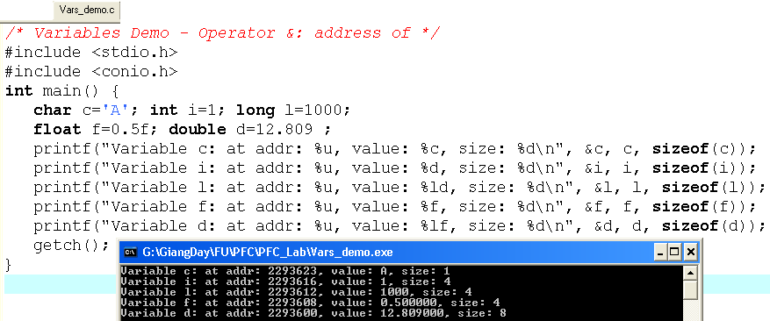
Variables and Data Types…
c:2293623
‘A’
Where are variables stored and how many bytes do they occupy?
1
i:2293616
1000
l:2293612
0.5
f:2293608
12.809
d:2293600
The operator & will get the address of a variable or code.
The operator sizeof(var/type) return the size (number of byte) occupied by a variable/type

Slide 10
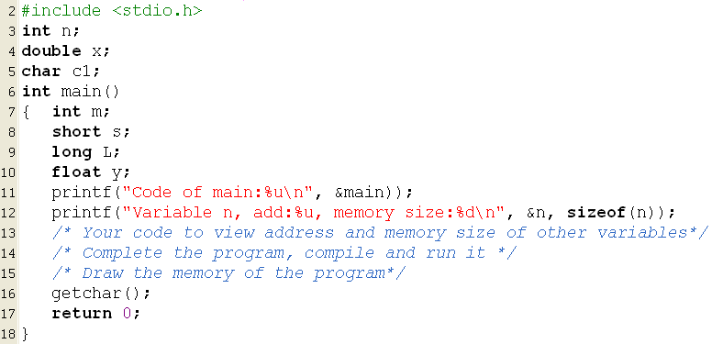
Do Yourself Now

Slide 11
Variables and Data Types…
Qualifiers:
We can qualify the int data type so that it contains a minimum number of bits.
Qualifiers:
short :at least 16 bits
long: at least 32 bits
long long: at least 64 bits
Standard C does not specify that a long double must occupy a minimum number of bits, only that it occupies no less bits than a double.
Notes:
Qualify (v): định tính chất
Specify (v): chỉ rõ, định rõ

Slide 12
Variables and Data Types…
Representation of Integral Values:
C stores integral values in equivalent binary form.
Non-Negative Values: số nguyên không âm
Intel uses this little-endian ordering.
Motorola uses big-endian ordering.
Each CPU family has it’s own way to store data . So, compilers must have a suitable way for copying data from this variable to other. And due to this reason also, each compiler can run well only on a specific family of CPU only. A supplier may supply some versions of their compiler for some CPU families.
09
Value is stored:
09F5E103
03
103
103
F5
E1
102
102
E1
F5
101
101
03
09
100
100
Least significant is stored in lowest byte
Most significant is stored in lowest byte
Notes:
Intel: lấy hàng đơn vị (03 trong dãy 09FSE103) lưu vào ô địa chỉ có giá trị nhỏ nhất

Slide 13
Variables and Data Types…
Exercises:
Convert the following decimal integers to binary:
63 __________________________________
219 _________________________________
Convert the following binary notation to decimal:
0111 0101 ___________________________
0011 1011 ___________________________
01011011 ___________________________

Slide 14
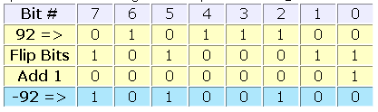
Variables and Data Types…
Negative and Positive Values:
Computers store negative integers using encoding schemes:
two's complement notation,
one's complement notation, and
sign magnitude notation.
All of these schemes represent non-negative integers identically.
The most popular scheme is two's complement.
To obtain the two's complement of an integer, we
flip the bits ( 1-complement)
add one → 2-complement
For example:
Notes:
Complement: phần bù
Notation: ký hiệu
Flip (v): đảo, lật

Slide 15
Variables and Data Types…
Exercises (Use signed 1-byte integral number):
What is the two's complement notation of
-63____________________________
-219___________________________
Convert the following binary notation to decimal:
1111 0101______________________
1011 1011______________________

Slide 16
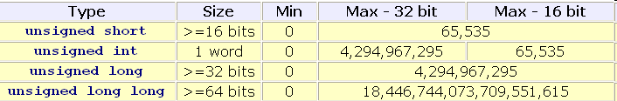
Variables and Data Types…
Unsigned Integers: Số nguyên dương
We can use all of the bits available to store the value of a variable.
With unsigned variables, there is no need for a negative-value encoding scheme.

Slide 17
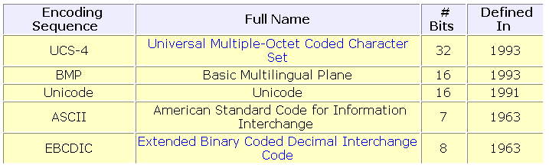
Variables and Data Types…
Cultural Symbols (characters):
We store cultural symbols using an integral data type.
We store a symbol by storing the integer associated with the symbol.
Over 60 encoding sequences have already been defined.
We use the ASCII encoding sequence throughout this course
Notes:
Associated (adj): liên hợp, liên kết

Slide 18
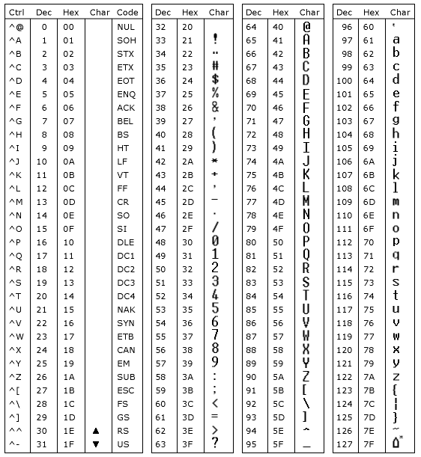
Variables and Data Types…
The ASCII table for characters

Slide 19
Variables and Data Types…
Exercises:
What is the ASCII encoding for
'0' ___________________________________________
'a' ________97 (dec) _____________________________
'A' ____________________65 (dec)_________________
What is the EBCDIC encoding for
'0' ___________________________________________
'a' ___________________________________________
'A' ___________________________________________
Convert the following binary notation to an ASCII character:
0110 1101 _____________________________________
0100 1101 _____________________________________
Convert the following decimal notation to an EBCDIC character:
199 ______________________
35 __________________________

Slide 20
Variables and Data Types…
Representation of Floating-Point Data :
Computers store floating-point data using two separate components:
an exponent and
a mantissa (phần định trị)
1.2345 = 1.2345 *10⁰
123.45 = 1.2345 *10²
1234.5 = 1.2345 *10³
0.0012345 = 1.2345 *10⁻³
Give your comment about position of the point mark and it’s mantissa
Notes:
Exponent : 10^0
Mantissa: 1.2345

Slide 21
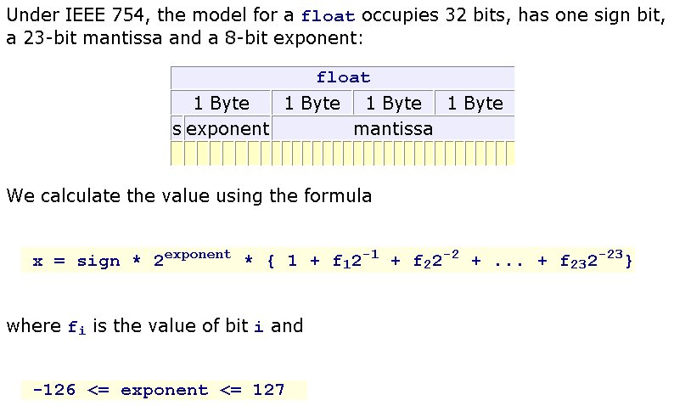
Variables and Data Types…
IEEE 754, 32 bits float:
Notes:
Số Bias : 2^8 -1 = 255/2 = 127.5 → 127

Slide 22
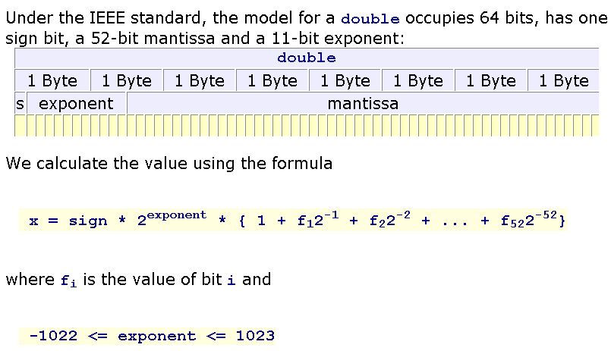
Variables and Data Types…
IEEE 754, 64 bits double :

Slide 23
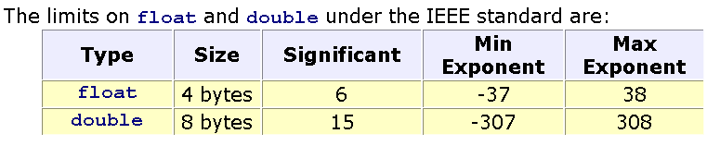
Variables and Data Types…
Limits on float and double data type in the IEEE standards:

Slide 24
Variables and Data Types…
Variable Declarations in C:
data_type identifier [= initial value];
For example:
char section;
int numberOfClasses;
double cashFare = 2.25;
Naming Conventions: Name is one word only
must not be a C reserved word
Some compilers allow more than 31 characters, while others do not. To be safe, we avoid using more than 31 characters.
Letter or ‘_’
Letters/digits/ ‘_’

Slide 25
Variables and Data Types…
Exercises:
Which of the following is an invalid identifier?
whale giraffe's camel_back 4me2
_how_do_you_do senecac.on.ca digt3 register
Select a descriptive identifier for and write a complete declaration for:
A shelf of books__________________________
A cash register___________________________
A part_time student_______________________
A group of programs______________________

Slide 26
Variables and Data Types…
Some operations on variables:
assign a constant value to a variable,
assign the value of another variable to a variable,
output the value of a variable,
input a fresh value into a variable's memory location.
constant
AnotherVar
anotherVar
Monitor
Keyboard
variable
File
File
Netwwork
Network
Notes:
-Chiều vào – variable – Chiều ra

Slide 27
Questions as Summary
What is a variable?
What is a data type?
Characteristics of a data type are …… and …
The size of the int data type is …. Bytes.
Choose the wrong declarations:
int n=10;
char c1, c2=‘A’;
int m=19; k=2;
char c3; int t;
float f1; f2=5.1;
Explain little-endian ordering and big-endian ordering.

Slide 28
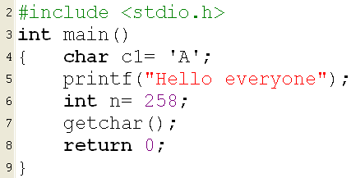
2- Literals
Constant values are specified directly in the source code.
They can be
Character literals (constant characters)
String literals(constant strings)
Number literals (constant numbers)
Notes:
Kí tự: ‘A’
Chuỗi: “Abcsca”
Specify (v): chỉ định

Slide 29
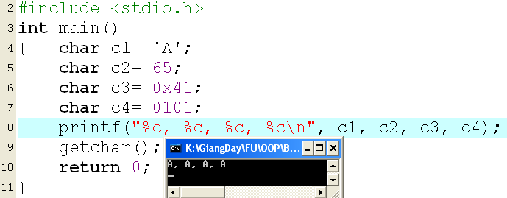
Literals: Characters, Strings
4 ways for representing a character literal:
04 ways:
Enclose the character single quotes - for example 'A',
Decimal ASCII code of the character : 65 for 'A‘
Octal ASCII code of the character: 0101 for 'A',
Hexadecimal ASCII code of the character: 0x41 for 'A',
Assign value to a variable:
The operator =

Slide 30
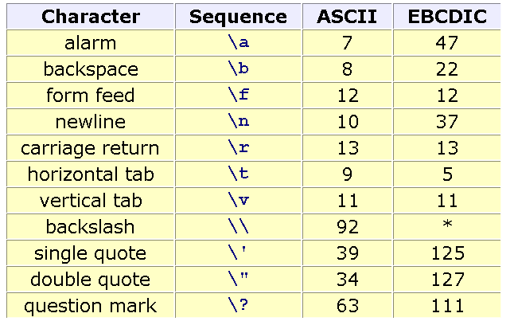
Literals: Escape Sequences
Pre-defined literals for special actions:

Slide 31
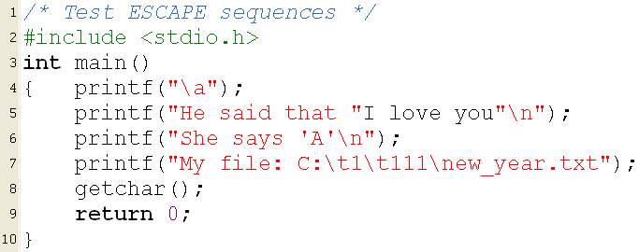
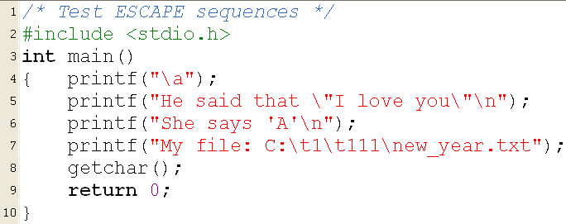
Literals: Escape Sequences…
Error! Why?
Modify then run it
Change \ to \\ then run it

Slide 32
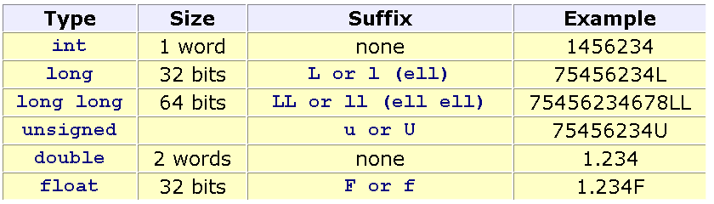
Literals: Numbers
The compiler will convert directly numeric literals (constants) to binary numbers and put them in the executable file. → How long of binary constants? → They depend on their data types specified by programmers.
Default: Integral value → int, real number → double
Specifying data type of constants: Suffixes after numbers.

Slide 33
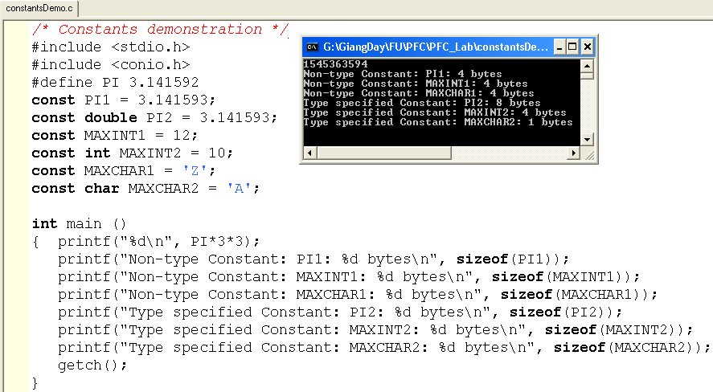
3- Named Constants
Use the pre-processor (pre-compiled directive) #define or the keyword const
Compiler will allocate memory location for constants that are declared using the keyword const
Notes:
HẰNG SỐ: con số có giá trị không thay đổi
Ứng dụng: giá trị ban đầu sẽ k thay đổi

Slide 34
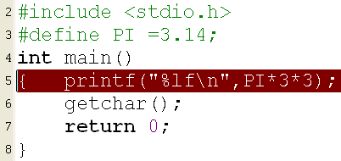


Named Constants…
Attention when the directive #define is used:
The compiler will not allocate memory block for values but all pre-defined names in the source code will be replaced by their values before the translation performs (The MACRO REPLACEMENT)
A name is call as a MACRO.
(… , PI*3*3)
(… , =3.14;*3*3)

Slide 35
Fill the blank
3 ways to specify a constant in a source program: use a literal, use the keyword…., and specify a macro using the directive …..

Slide 36
4- Input/Output Variables
Monitor is
a character
device
3
3
Binary code of 3 for calculating
Convert
00110011
ASCII code of the digit
3
00110011
00000011
convert
00110011
Keyboard is
a character
device
3
3
Data inputted from keyboard are ASCII codes
Data printed out to monitor are ASCII codes
Conversion rules are pre-defined in C

Slide 37
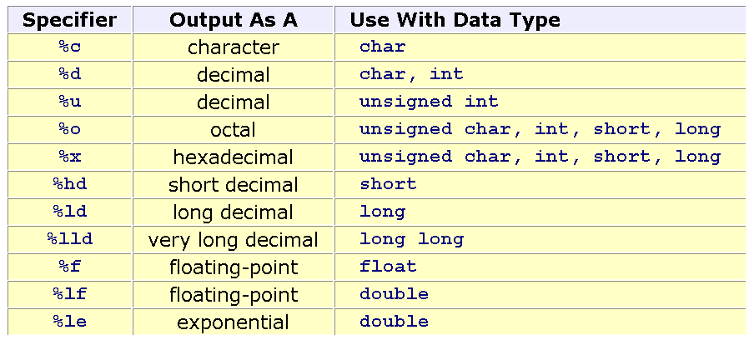
Input/Output Variables…
Conversion Specifiers
Notes:
In Kí tự: %c
In Giá trị: %d

Slide 38
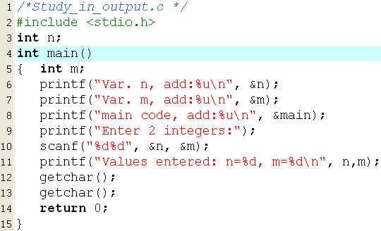
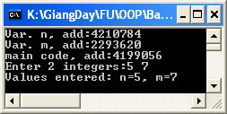
Input/Output Variables…
4210784
n
main
4199056
2293620
m
Format string
scanf( “%d%d”, &n, &m) →
scanf( “%d%d”, 4210784, 2293620) means that get keys pressed then change them to decimal integers and store them to memory locations 4210784, 2293620.
Notes:
% là kí tự để xuất “định dạng của giá trị”

Slide 39
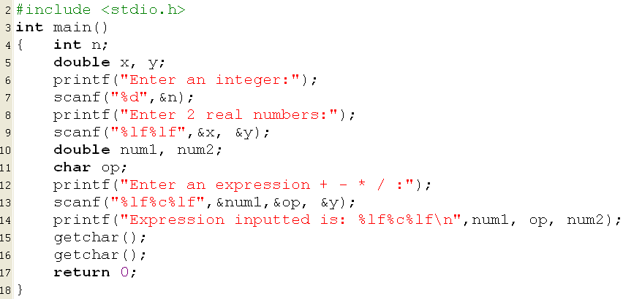


Input/Output Variables…
Input a value to a variable:
scanf (“input format”, &var1, &var2,…)
Output the value of a variable:
printf (“output format”, var1, var2,…)
The function scanf receive the BLANK or ENTER KEYS as separators.
Format string
Data holders
Notes:
Int x → x là tên định danh
Printf lấy giá trị ra
Scanf gắn giá trị cho biến x

Slide 40
Questions
Explain means of parameters of the scanf(…) and the printf(…) functions.
Use words “left” and “right”. The assignment x=y; will copy the value in the ….. side to the ….. Side.
Notes:
Review
Biến số
Giá trị
Gán giá trị cho biến
Hằng số - const; - #define
%d, %f, %c
Printf
Scanf

Slide 41
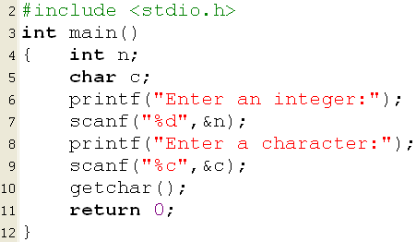
Exercises
1- Develop a C program in which 2 integers, 2 float numbers and 2 double numbers are declared. Ask user for values of them then print out values and addresses of them. Write down the memory map of the program.
2- Run the following program:
Why user do not have a chance to stroke the ENTER key before the program terminate?
Modify and re-run:
getchar();
getchar();

Slide 42
5- Expressions
Expression is a valid association of constants, variables, operators and functions and returns an only result.
Examples:
32-x+y/6 16.5 + 4/sqrt(15) * 17 – 8
45 > 5*x y = 17 + 6*5/9 –z*z
Hardware for calculating expressions: ALU
Operations that can be supported by ALU: Arithmetic, relational and logic operations.
Notes:
Biến số chỉ là cách Biểu Thị
Kết quả cuối cùng phải là GIÁ TRỊ

Slide 43
Expressions: Arithmetic Operators
Op. | Syntax | Description | Example
+ | +x | leaves the variable, constant or expression unchanged | y = +x ; ←→ y = x;
- | -x | reverses the sign of the variable | y= -x;
+ - | x+y x-y | Add/substract values of two operands | z= x+y; t = x-y;
* / | x*y x/y | Multiplies values of two operands Get the quotient of a division | z= x-y; z = 10/3; → 3 z = 10.0/3; → 3.3333333
% | x%y | Get remainder of a integral division | 17%3 → 2 15.0 % 3 → ERROR
++ -- | ++x --x x++ x-- | Increase/decrease the value of a variable (prefix/postfix operators) | Demo in the next slide.

Slide 44
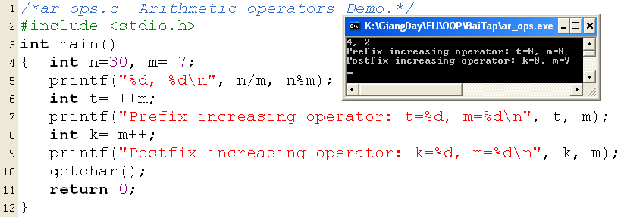
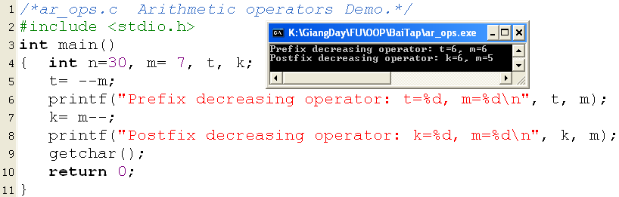
Expressions: Arith. Operators…
Explain yourself the output

Slide 45
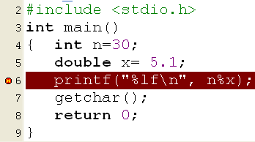

Expressions: Arith. Operators…
?
Explain yourself the output
Statistic:
Multiply > Division
Integral operations > floating-point ones.

Slide 46
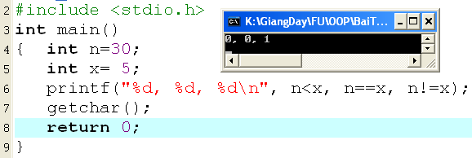
Expressions: Relational Operators
For comparisional operators.
< <= == >= > !=
Return 1: true/ 0: false

Slide 47
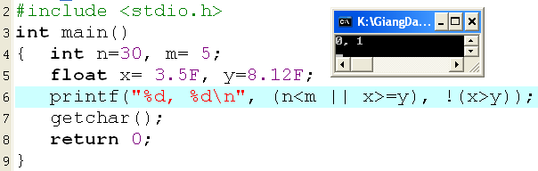
Expressions: Logical Operators
Operator for association of conditions
&& (and), || (or) , ! (not)
Return 1: true, 0: false

Slide 48
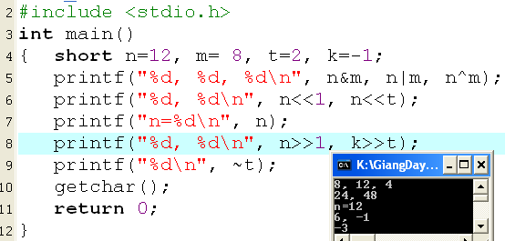
Expressions: Bitwise Operators
& (and), | (or) , ^ (xor): Will act on a pair of bits at the same position in 2 operands.
<< Left shift bits of the operand (operands unchanged)
>> Right shift bits of the operand (operands unchanged, the sign is preserved.)
~ : Inverse bits of the operand.
n&m
0000 0000 0000 1100
0000 0000 0000 1000
0000 0000 0000 1000 → 8
n=12: 0000 0000 0000 1100
m= 8: 0000 0000 0000 1000
n|m
0000 0000 0000 1100
0000 0000 0000 1000
0000 0000 0000 1100 → 12
n^m
0000 0000 0000 1100
0000 0000 0000 1000
0000 0000 0000 0100 → 4

Slide 49
Expressions: Bitwise Operators…
n=12: 0000 0000 0000 1100
n<<1:
0000 0000 0000 1100
0000 0000 0001 100 ← 0
0000 0000 0001 1000 (24₁₀)
Left shift 1 bit: multiply by 2
n=12: 0000 0000 0000 1100
n>>1:
Sign: 0
0000 0000 0000 1100
0000 0000 0000 110
Add the sign to the left”
0000 0000 0000 110 ➔ 6
k=-1:
1: 0000 0000 0000 0001
-1: 1111 1111 1111 1111 (2-complement)
Sign: 1
1111 1111 1111
111 1111 1 111 1111
Add the sign to the left:
1111 1111 1111 1111 → (-1₁₀)

Slide 50
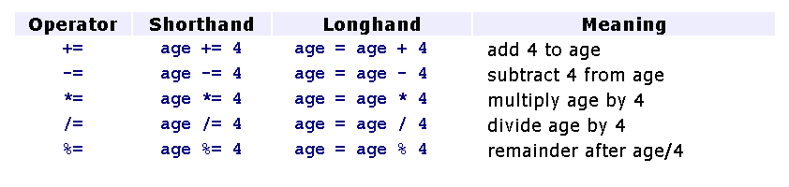
Expressions: Assignments Operators
Variable = expression
Shorthand assignments:
Notes:
Phép toán gán

Slide 51
Expressions: Mixing Data Types
Although the ALU does not perform operations on operands of differing data type directly, C compilers can interpret expressions that contain operands of differing data type.
If a binary expression contains operands of differing type, a C compiler changes the data type of one of the operands to match the other.
Data type hierarchy: double, float, long, int , char .
Notes:
Quy tắc ép kiểu:
Int thực hiện các phép toán (+-*/) với 1 int → int
Float ………………………. → float
Int ………………. Float → float
Có 2 cách ép kiểu:
Implicit: kiểu ngầm định (2.0/4; 2/4.0; 2.0/4.0)
Explicit: kiểu tường minh ((float)2/4)
Nhưng có trường hợp sai lầm: (float)(2/4) = 0.0
Vd:
int x;
x=10;
* Float y =x; → Implicit
* y = (float)x; → Explicit

Slide 52
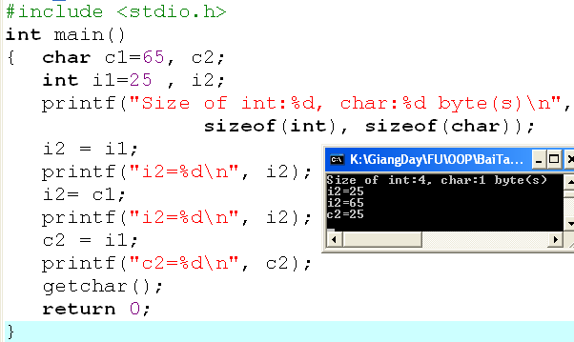
Expressions: Mixing Data Types
Casting Data Type: x = y;
00000000
00000000
00000000
00000000
00000000
00000000
00011001
00011001
00000000
00000000
00000000
01000001
01000001
00000000
00000000
00000000
01000001
00011001
Direction for copying: From the lowest byte to higher bytes

Slide 53
Expressions: Mixing Data Types
Implicit Casting for the assignment
If the data type of the variable on the left side of an assignment operator differs from the data type of the right side operand, the compiler
promotes the right operand to the data type of the left operand if the left operand is of a higher data type than the right operand,
truncates the right operand to the data type of the left operand if the left operand is of a lower data type than the right operand.
0000 0000
0000 0000
0000 0000
0100 0001
0100 0001
0000 0000
0000 0000
0000 0000
0001 1001
0001 1001

Slide 54
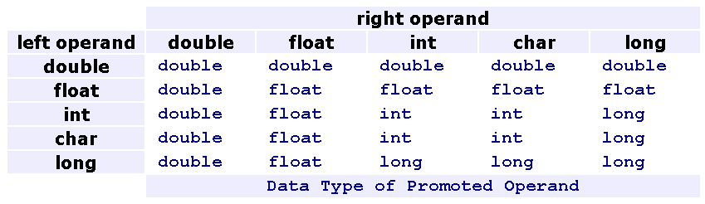
Expressions: Mixing Data Types
Implicit Casting for arithmetic and relational expressions
If the operands in an arithmetic or relational expression differ in data type, the compiler promotes the value of lower data type to a value of higher data type before implementing the operation.
int n=3; long t=123; double x=5.3;
3*n + 620*t – 3*x
(int*int) + (int*long) - (int*double)
int + long - double
long - double
double
Notes:
Quy tắc ép kiểu:
Int thực hiện các phép toán (+-*/) với 1 int → int
Float ………………………. → float
Int ………………. Float → float

Slide 55
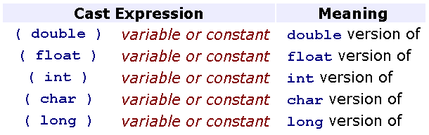
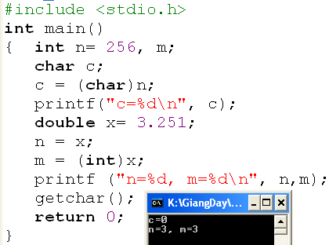
Expressions: Mixing Data Types
Explicit Casting
We may temporarily change the data type of any operand in any expression to obtain a result of a certain data type.
00000000
00000000
00000001
00000000
00000000
c
n

Slide 56
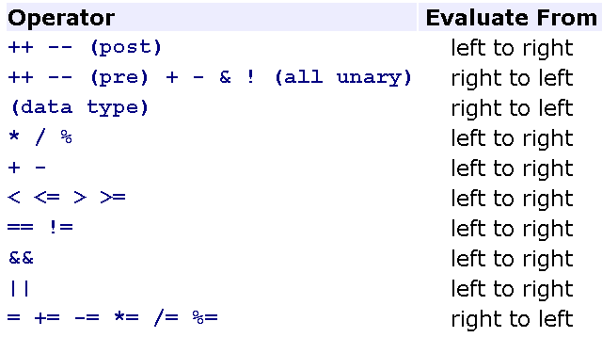
Expressions: Operator Precedence
In a expression containing some more than one operator. Which operator will perform first? → Pre-defined Precedence.
We can use ( ) to instruct the compiler to evaluate the expression within the parentheses first
int m=3, k=2, n=4;
What is the results?
m<n
k<m<n
k>m>n
m<n>k
m&& k<n

Slide 57
Summary
Variable is ……
Basic memory operations are…..
Expression is ……….
Which of the following operators will change value of a variable? + - * / % ++
Which of the following operators can accept only one operand? + - * / % --
13 & 7 = ?
62 | 53 = ?
17 ^ 21 = ?
12 >> 2 = ?
65 << 3 = ?

Slide 58
Summary
Expressions
Arithmetic operators
Relational operators
Logical operators
Bit operators
Shorthand Assignment Operators
Casting
Precedence

Slide 59
Thank You

